Slide 1


Wildlife Strikes in Aviation
VLAD LEE

Slide 2




Background
Wildlife strikes pose significant risk to aviation safety
Since 1988, over 490 fatalities and 350 aircraft destroyed
Source: FAA
In 2024, there were 14,774 strikes at over 2,600 airports
Steadily rising number of strikes
25% decrease from 2023 to 2024
Other Wildlife
Deer make up nearly 4% of all reported strikes

Slide 3
Data
Data obtained from the official FAA Wildlife Strike Database: https://wildlife.faa.gov/
311,500 reported strikes from 1990-2025
Reporting is voluntary
101 columns including: Operator, species, location, specific parts struck or damaged, cost
Data cleaning:
Combined cost repairs and cost other, clean special characters,
binary indicator for injuries/fatalities
Data is hosted in a Snowflake database
Use dynamic queries for efficiency, optimization, and cost reduction

Slide 4

Objectives and Research Questions
1
Analyze and visualize strike data
2
Identify temporal, seasonal, and spacial trends
3
Determine parts most at risk
4
Improve early detection systems and assess effectiveness of mitigation strategies

Slide 5

Streamlit App
Link to App

Slide 6
Regression Analysis

Slide 7
Regression Analysis
Predict cost based on height, speed, and distance
Estimation Period: 1990-2025
Log transformation

Slide 8
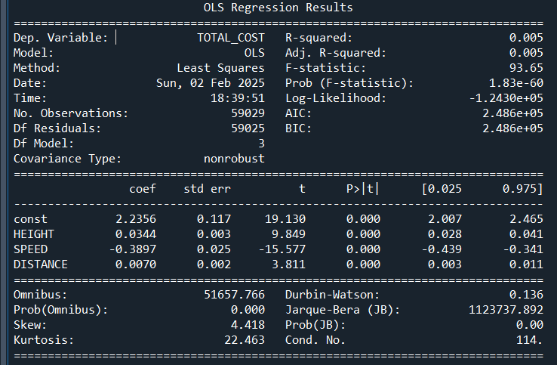
Regression Results
Overall model is significant
Significant coefficients
Low R-squared

Slide 9
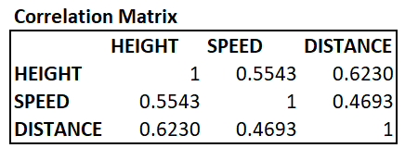
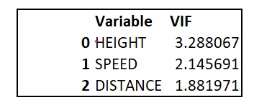
Multicollinearity
Independent variables are highly correlated
VIFs are below the accepted threshold of 5

Slide 10

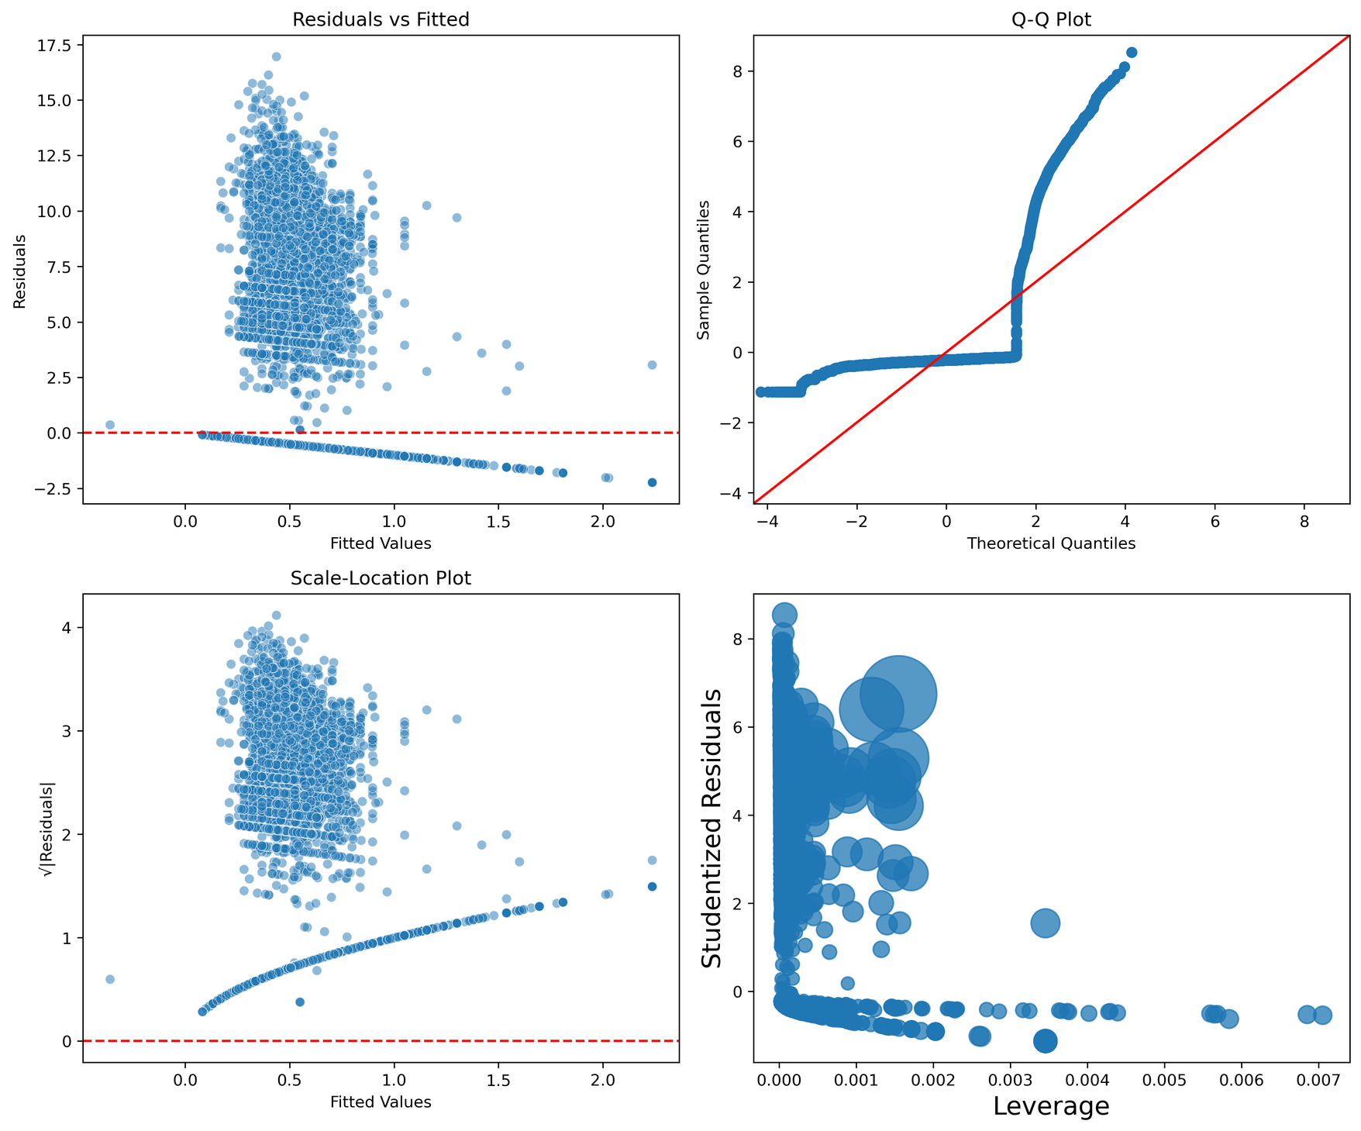
Residual Plots
Visible pattern in Residual vs Fitted and Scale-Location plots
Residuals not normally distributed
High leverage points observed

Slide 11
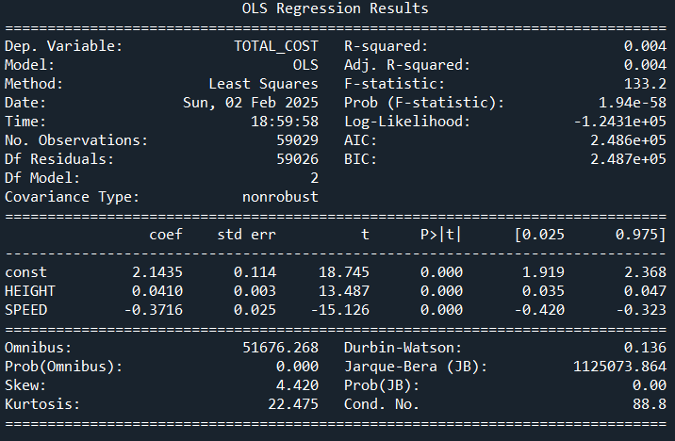
Regression Results
Dropping Distance Variable
Overall model is significant
Significant coefficients
Low R-squared

Slide 12
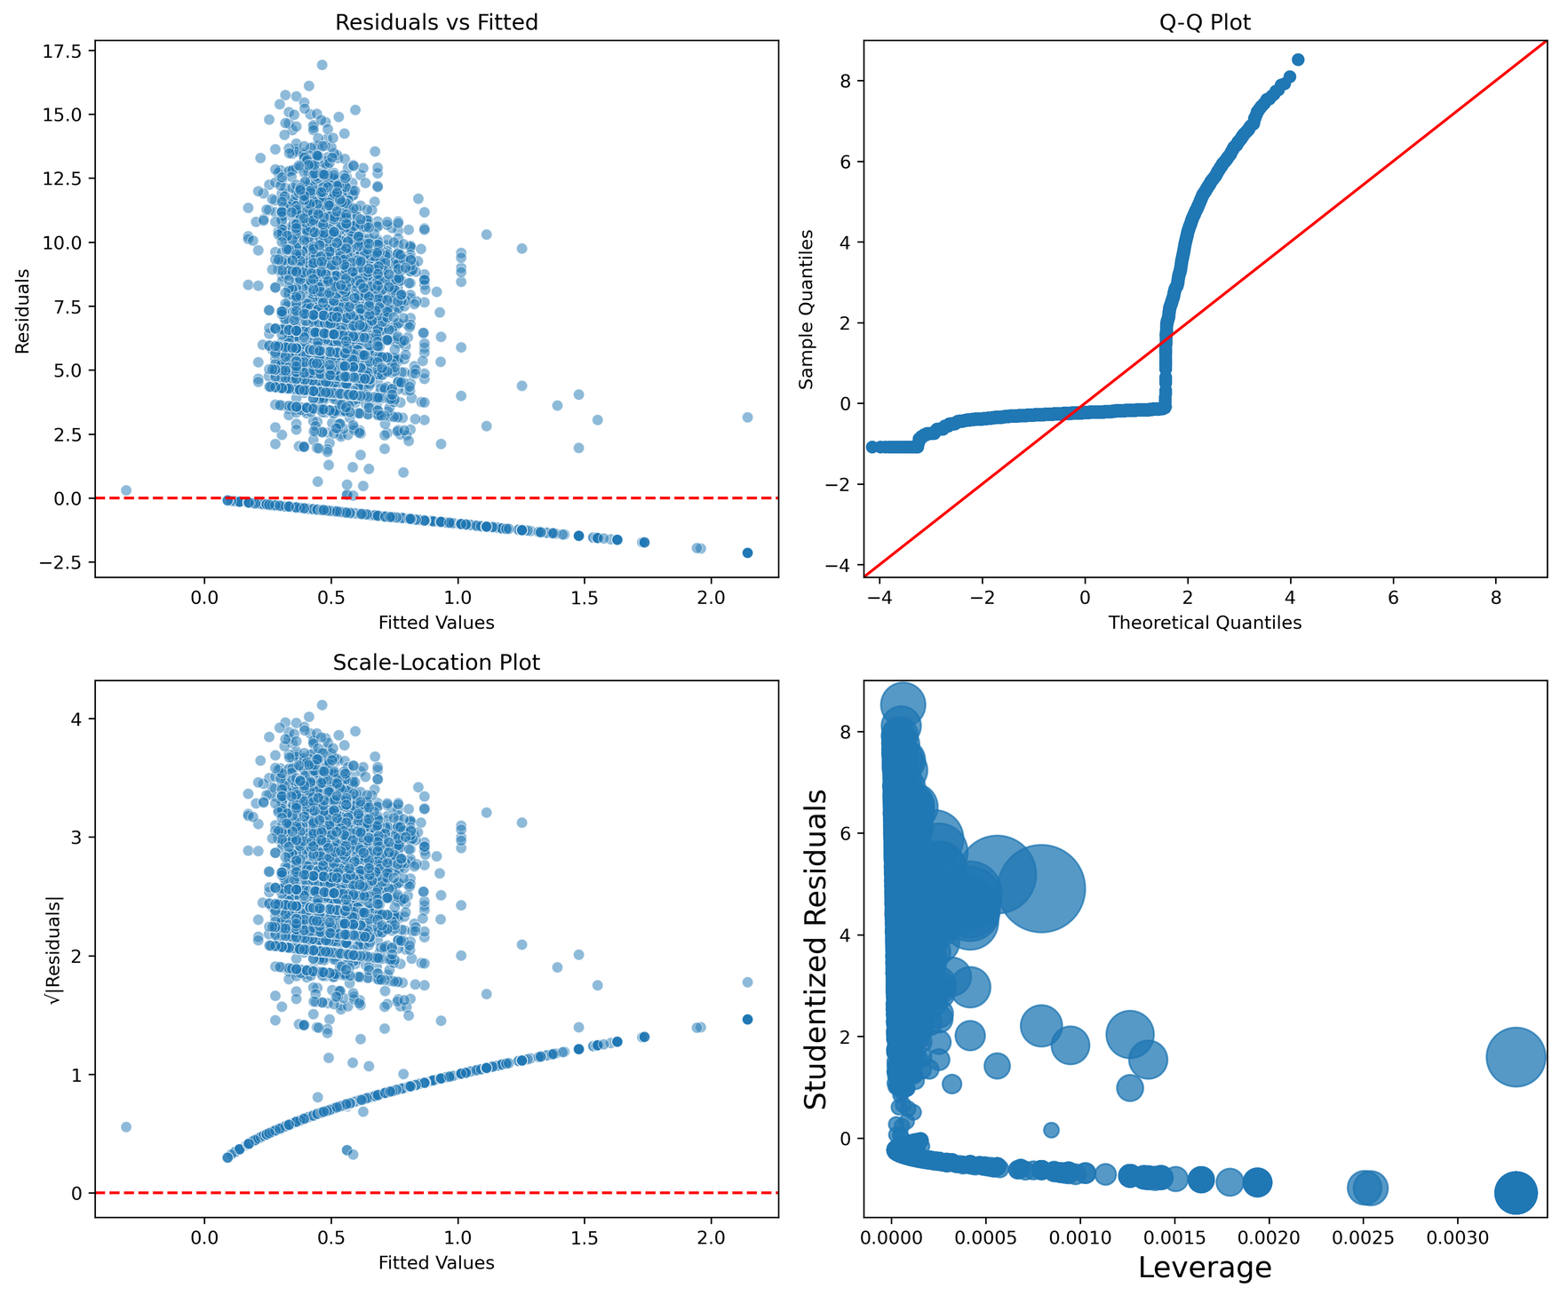
Residual Plots
Visible pattern in Residual vs Fitted and Scale-Location plots
Residuals not normally distributed
High leverage points observed

Slide 13
Random Forest Model

Slide 14
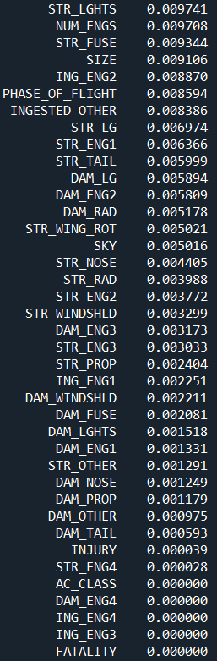
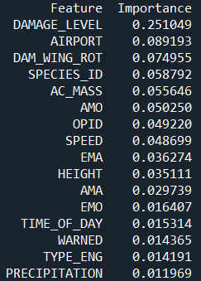
Random Forest Model Results
56 Total variables
Continuous Variables: Cost, Height, Speed, Distance
Categorical Variables: Time of Day, location, Engine Type, Aircraft Type, Species, Injury, Fatality, Damage to specific parts
Parameters: 20% Test 80% Train, Number of Estimators = 500, Min Sample Split = 10
Minimal effect on results with 100 estimators, min split of 2
MSE = 3.24
MAE = 0.72
R-Squared = 23.61%

Slide 15
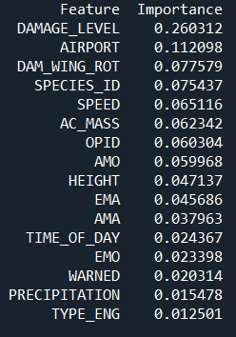
Random Forest Model Results
Dropping Less Important Features
15 Total variables
MSE = 3.23
MAE = 0.73
R-Squared = 23.79%

Slide 16
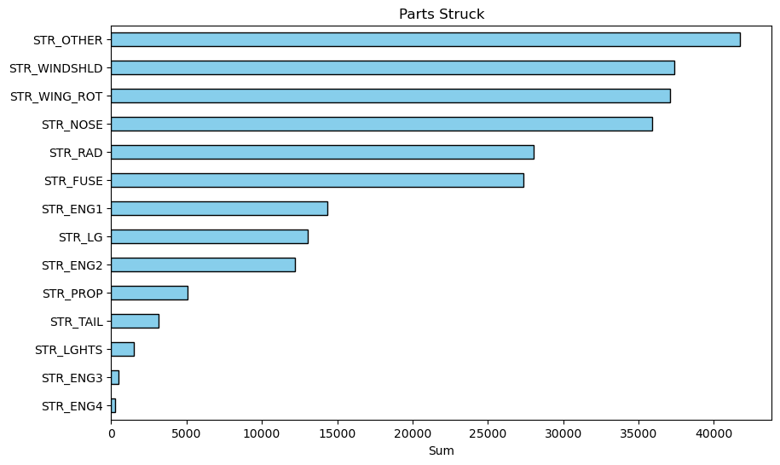
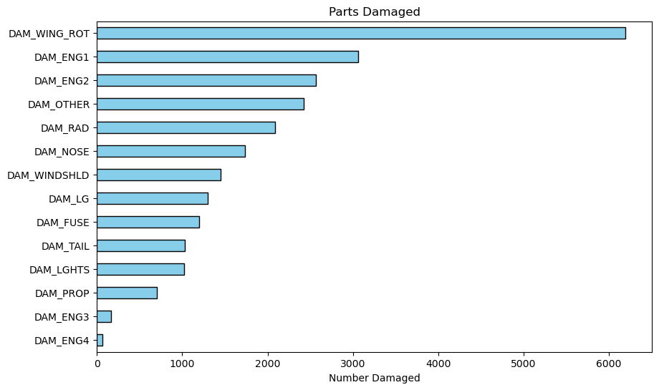
Most Struck and Damaged Parts

Slide 17
Conclusions
Wing and engines are most vulnerable to damage
Increase wildlife surveillance during peak seasons hours
Q3 (July - September), 7 A.M. to 11 A.M.
Improve wildlife management programs
Habitat modification and bird deterrents
Improve aircraft design
Target most vulnerable parts
Special lighting to repel wildlife

Slide 18
Future Work and Considerations
Regional risk assessment using Location data
Logistic regression to predict likelihood of strike
Compare to international data

Slide 19
Links and Citations
Github Repo
Linkedin
NERA

